Slide 1
Lynch Biologics
Recombinant Human PDGF and Bone Grafts
Helen Newman, PhD
Founder & Director
Veterinary Transplant Services
AVORE Coeur d’ Alene Jul2021

Slide 2
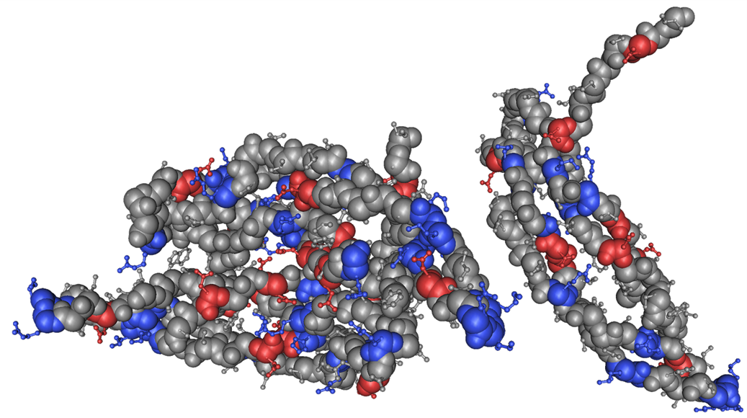
Platelet-Derived Growth Factor (PDGF)
Defined Mechanism of Action
PDGF recruits cells from surrounding tissue (chemotaxis)
PDGF causes recruited cells to multiply (mitogenesis)
PDGF elicits the creation of new blood vessels (angiogenesis)
Rendering of PDGF-BB Molecule
Notes:
Dimer “BB”

Slide 3
Turning PDGF into a therapeutic - rhPDGF-BB
rhPDGF-BB is one of only 2 recombinant tissue growth factors approved for human use
It is the Only growth factor that has been proven in human and animal clinical trials to promote healing of both bone and soft tissues
It is the active component in 4 FDA approved therapeutic products on the human market
including products proven to promote healing of orthopedic and dental and skin wounds

Slide 4
Why choose PDGF-BB isoform?
 | α/α Receptor | α/β Receptor | β/β Receptor
PDGF-AA | ✓
PDGF-AB | ✓ | ✓
PDGF-BB | ✓ | ✓ | ✓
PDGF-CC | ✓ | ✓
PDGF-DD |  | ✓ | ✓
PDGF-BB | ✓ | ✓ | ✓
rhPDGF-BB isoform signals through all the receptors

Slide 5
Turning PDGF into a therapeutic - rhPDGF-BB
rhPDGF-BB produced using recombinant DNA technology
The human gene for PDGF-BB is inserted into yeast cells
Saccharomyces cerevisiae
Recombinant PDGF-BB is:
Pure
Sterile
Synthetic
Consistent concentration
Now available for veterinary use
Notes:
So unlike PRP or PRF fractions that contain varying concentrations of platelets and white cells this is a pure infusion of PDGFDimer “BB”

Slide 6
PDGF triggers the bone healing cascade
.
injured bone
activated
platelets
.
factors released from bone matrix
FGF
TGF
PDGF
BMPs
PDGF
progenitor cells
proliferation
chemotaxis
differentiation
blood vessels
VEGF
osteoblasts
chondrocytes
angiogenesis
remodeling
osteoblast
}
mature bone
formation
.
.
osteoclast
resorption
.
.
Jeff Hollinger, 2006
Notes:
Slide is animated

Slide 7
Chemotaxis
5X difference
Fielder, 2002
PDGF most potent chemotactic agent for mesenchymal cells

Slide 8
rhPDGF “cell homing” action
PDGF is released at sites of injury causing healing cells to move to the wound
rhPDGF then stimulates proliferation of new cells, growth of blood vessels, and ultimately tissue regeneration

Slide 9
Mitogenesis
Wildemann, 2007
PDGF is a potent mitogen for MSCs and osteoblasts

Slide 10
Mitogenesis Comparison
PDGF is the most potent mitogen for MSCs
2500%
2000%
1500%
Relative to Control
1000%
500%
EGF
FGF-2
IGF-2
HGF
BDNF
ANP
IL-8
MCP-1
IL-2
SDF-1a
SCF
HB-EGF
PDGF-AB
SCGF-a
NGF-β
PDGF-AA
Leptin
BMP-2
TGF-β3
TGF-β1
PDGF-BB
Thrombin
23 unique growth factors/cytokines
Mesenchymal Stem Cells (Rabbit), ³H DNA Synthesis Assay, Data from Ozaki 2007
Published in Journal of Stem Cells and Development

Slide 11
Angiogenesis
Formation of new blood vessels from pre-existing vessels
Regulated by expression of VEGF (a molecule closely related in morphology to PDGF)
Criticality of angiogenesis to healing process
Deliver nutrients/oxygen
Eliminate waste
Permit physical ingress of cells
Permit ingress of factors to direct healing

Slide 12
Angiogenic effects
rhPDGF-BB upregulates gene expression
Small amounts for brief periods have longer lasting effects because it amplifies downstream signals involved in healing cascade
Bouletreau, 2007
rhPDGF upregulates VEGF, critical in formation of new blood vessels

Slide 13
Pharmacokinetcs: 50% of the ¹²⁵I-rhPDGF-BB in Augment is released within the first 30 minutes
80% of rhPDGF-BB released within 24 hours

Slide 14
Pharmacokinetics: ¹²⁵I-labeled rhPDGF-BB is cleared rapidly from circulation
The half-life (T₅₀) of rhPDGF-BB in circulation is 2.3 minutes

Slide 15
rhPDGF-BB is distributed and eliminated by the normal secretory routes
study outcomes
rhPDGF-BB is cleared rapidly from the circulation
Free ¹²⁵I is eliminated via the kidneys in the urine after degradation of the rhPDGF-BB in liver or other tissues
rhPDGF-BB distribution and secretion is
the same as for endogenous PDGF

Slide 16
A comprehensive battery of safety studies: No adverse findings
Systemic IV toxicity (single dose)
Up to 100 x maximum human dose in rats
Repeat-dose IM toxicity (QOD for 14 days)
Up to 28x maximum human dose in rats
Carcinogenicity (1-year follow-up)
Up to 4x maximum human dose in rats
Reproductive and developmental toxicity (QD for 21 days)
Up to 210x maximum human dose in rats
Systemic and local toxin non-human primates (single injection)
Up to 2x maximum human dose in baboons
Genotoxicity
Bacterial mutagenicity test - AMES assay
Local tolerance
Biocompatibility studies (ISO 10993)
Immunogenicity
Notes:
Hit message of why top four only are focus. Also make sure to lead with the summary of message regarding safety rather than waiting till end

Slide 17
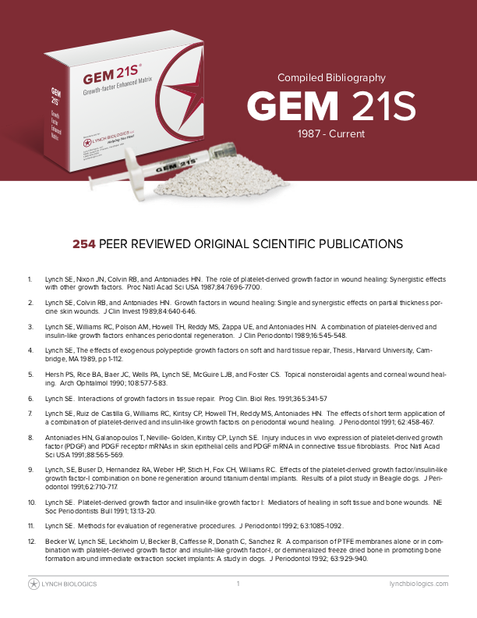
rhPDGF-BB: Enormous Number of Publications
The Evidence
Over 250 Peer Reviewed Articles
8 Book Chapters
3 Decades of Research & Development by LBIO Alone...and counting!

Slide 18
Preclinical studies – Efficacy
Fracture healing of the tibia in geriatric-osteoporotic rats Hollinger et al. J Orthop Res, 2008
Fracture healing of the femur in a diabetic rat model Al-Zube et al. J Orthop Res, 2009
Bone formation in a rat model of distraction osteogenesis Moore et al. J Bone Joint Surg Am, 2009
Partial arthrodesis of the carpus in a canine model
Internal BMTI report

Slide 19
Fracture healing in geriatric-osteoporotic rats
This study was designed to evaluate:
Enhancement of fracture repair by Augment in a model in which bone repair is impaired
Dose-dependence of the rhPDGF-BB effect
Group No. | Treatment | No. Animals 3 weeks/5 weeks
1 | Untreated | 10 / 10
2 | Matrix + 20 mM sodium acetate | 10 / 10
3 | Matrix + 0.3 mg/mL rhPDGF-BB | 10 / 10
4 | Matrix + 1.0 mg/mL rhPDGF-BB | 10 / 10
rhPDGF-BB in 20 mM sodium acetate, pH 6.0
Hollinger et al., JOR 2008

Slide 20
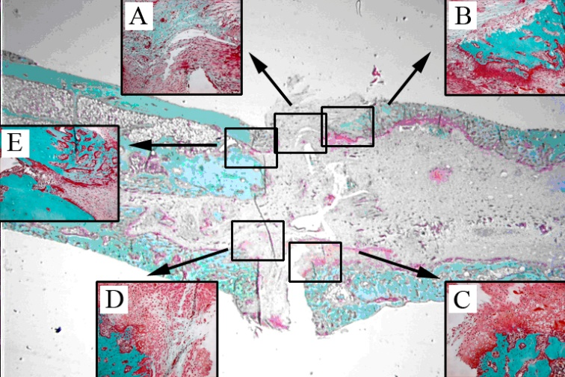
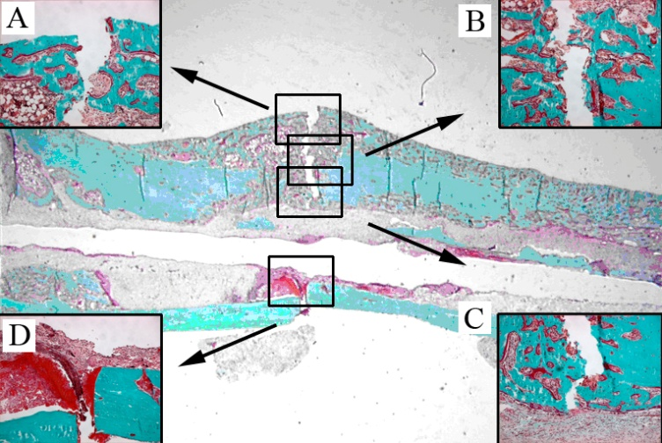
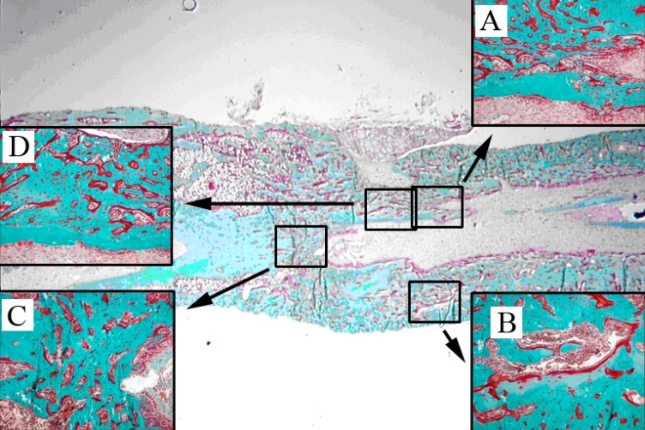
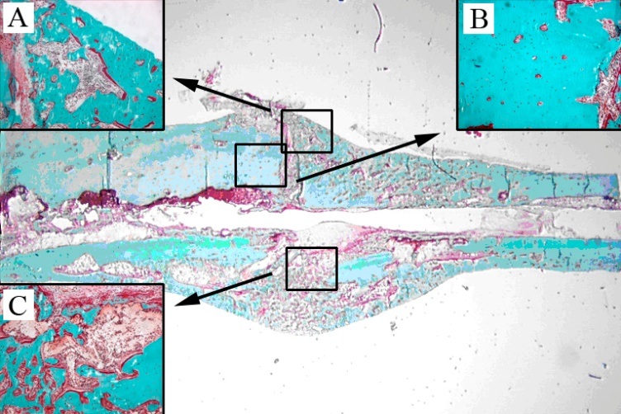
rhPDGF-BB accelerates fracture healing in geriatric osteoporotic rats
5 weeks
Untreated
Matrix
Matrix + 0.3 mg/mL rhPDGF-BB
Matrix + 1.0 mg/mL rhPDGF-BB
Notes:
MOCK FEEDBACK: Slide too busy. Needs improvement and simplification

Slide 21
The mechanical strength of Augment-treated limbs is similar to contralateral normal limbs
*
*
Untreated
Matrix
Matrix +
0.3 mg/mL rhPDGF-BB
Matrix +
1.0 mg/mL rhPDGF-BB
* Significantly weaker than contralateral normal (p<0.05)

Slide 22
Augment accelerates fracture healing in geriatric-osteoporotic rats
Conclusions
Matrix plus rhPDGF-BB accelerated fracture healing
At five weeks, the mechanical strength of Augment-treated tibias was not different from normal
There were no untoward tissue responses
Notes:
MOCK FEEDBACK: Note that study uses collagen, why is this comparable
MOCK FEEDBACK: Emphasize biological basis for tissue regeneration
MOCK FEEDBACK: Prepare for question re how does BMP-2 compare to PDGF

Slide 23
Fracture healing of the femur in a diabetic rat model
This study was designed to evaluate:
Enhancement of fracture repair by rhPDGF-BB in an impaired healing model
Dose-dependence of the rhPDGF-BB effect
Group No. | Treatment | No. Animals 4 days/6 weeks/8 weeks/ 12 weeks
1 | Untreated | 6 / 8 / 10 / 5
2 | Matrix + 20 mM sodium acetate | 6 / 10 / 13 / 5
3 | Matrix + 0.3 mg/mL rhPDGF-BB | 7 / 7 / 10 / 4
4 | Matrix + 1.0 mg/mL rhPDGF-BB | 7 / 7 / 12 / 4
rhPDGF-BB in 20 mM sodium acetate, pH 6.0
Al-Zube et al., JOR 2009
Notes:
MOCK FEEDBACK: Soften mention of “my personal lab”
MOCK FEEDBACK: Why were these concentrations used

Slide 24
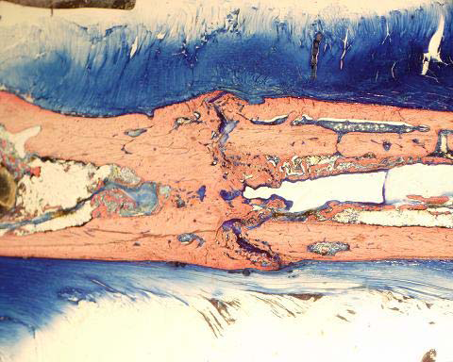
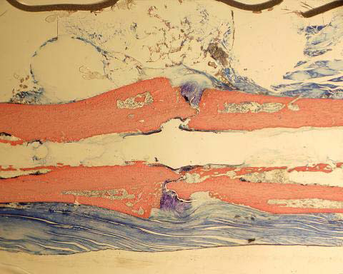
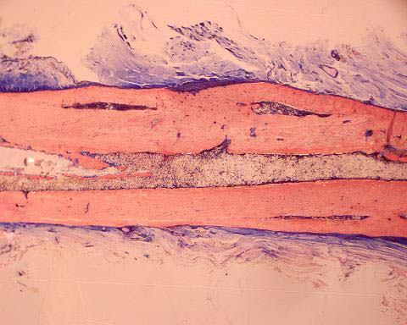
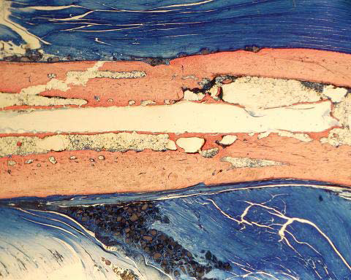
rhPDGF-BB treatment enhances fracture healing in diabetic rats
12 weeks
Untreated Fracture
Matrix
Matrix + 0.3 mg/mL rhPDGF-BB
Matrix + 1.0 mg/mL rhPDGF-BB

Slide 25
Augment enhances fracture repair in diabetic rats
Conclusions
Augment enhances long bone healing in diabetic rats
Increased cell proliferation at 4 days
Increased biomechanical strength as early as 6 weeks
Increased bone content of the fracture callus at 12 weeks
No evidence of either abnormal or ectopic bone formation

Slide 26
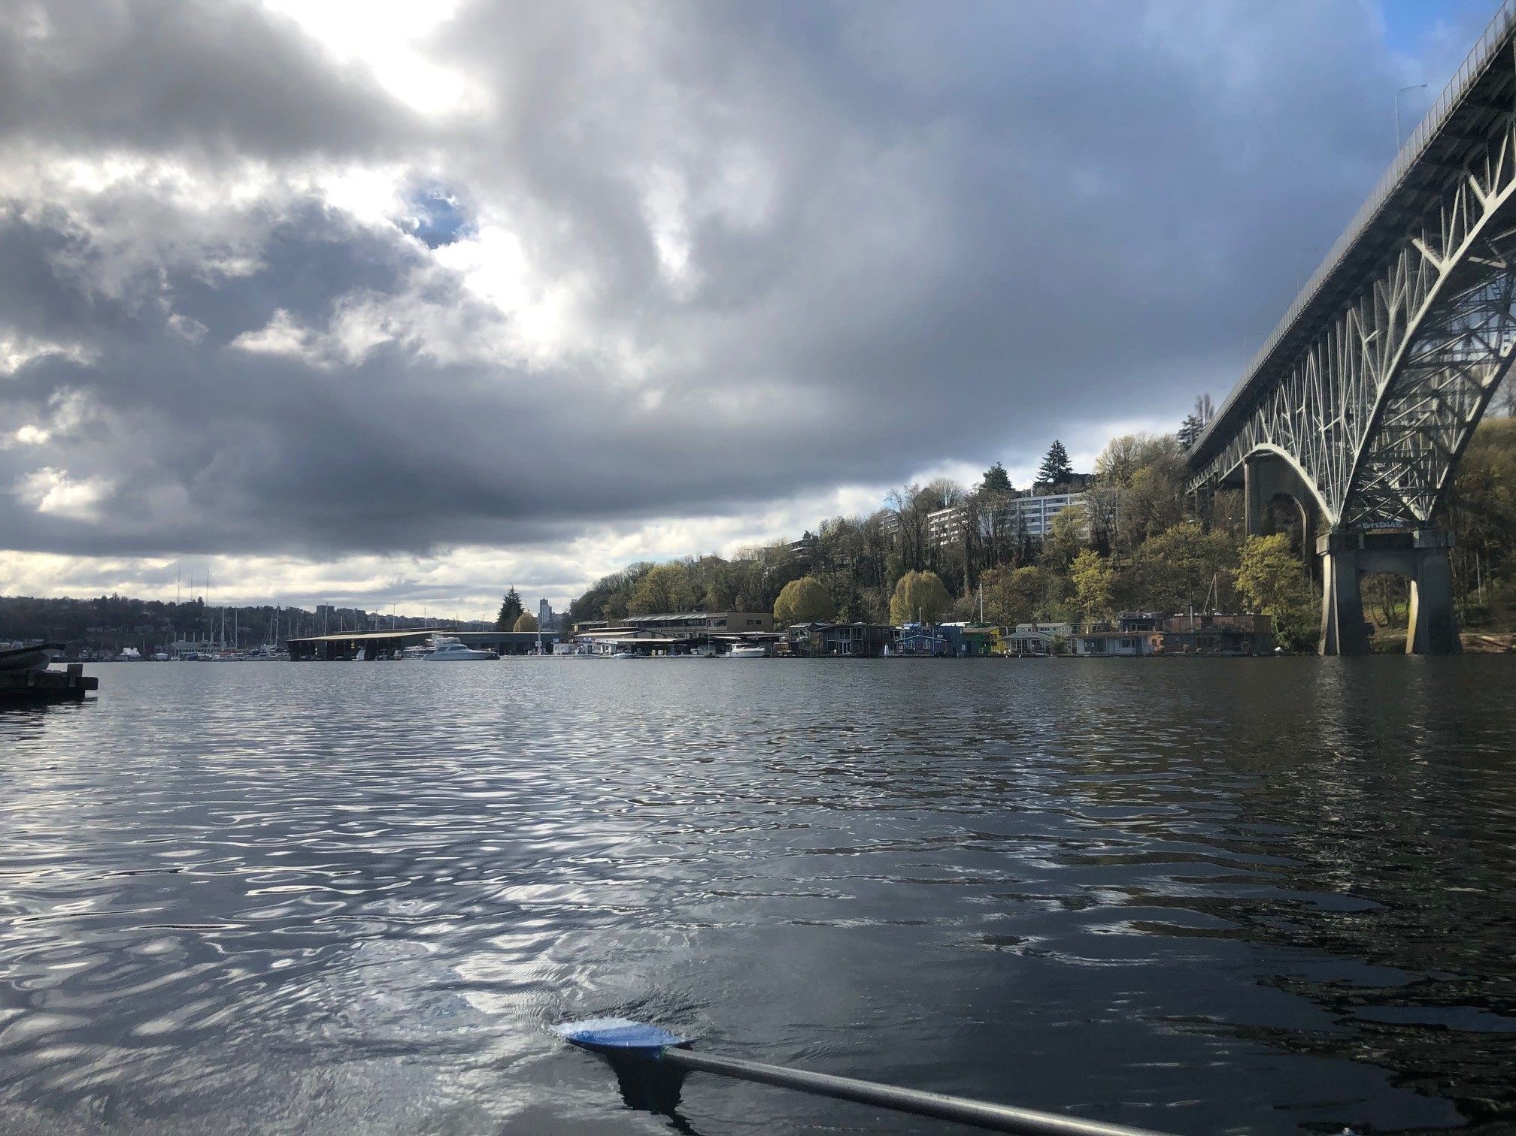
Clinically Relevant Studies
(next!)

Slide 27
Patients with non-unions have decreased levels of PDGF and VEGF at the fusion site
#
*
*: p = 0.016
#: p = 0.031
Pinzur, et al, in press
Notes:
Ensure consistent reference LN, et al, Date or (in press)

Slide 28
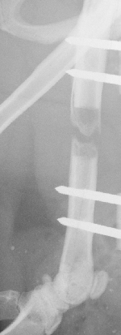
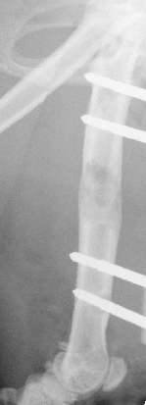
rhPDGF-BB accelerates the consolidation of the distraction callus
Rats (n=83)
7 mm femoral lengthening procedure:
Weekly injections of saline or rhPDGF-bb
Assessed up through 63 days
Healing assessed with serial rads, micro CT, and histology
Overall union rate was 40.4% compared to 4.5% in controls
Conclusion: administration of exogenous rhPDGF-BB during distraction enhances healing (in rats!)
Distraction at day 56
Control
+ rhPDGF-BB

Slide 29
rhPDGF-BB promotes the consolidation of the distraction callus
Assessment of fusion by MicroCT
Day | Controls |  | rhPDGF-treated
 | Buffer | Collagen | 0.1 mg/mL | 0.3 mg/mL | 1.0 mg/mL
35 | 0/3 | 0/1 | 0/3 | 0/3 | 0/3
42 | 0/3 | 0/3 | 1/3 | 2/3 | 1/3
49 | 0/3 | 0/2 | 1/3 | 1/3 | 1/3
56 | 0/2 | 0/1 | 2/3 | 2/3 | 0/3
63 | 0/3 | 1/1 | 2/3 | 4/4 | 2/4
Total | 1/22 (5%) |  | 19/47 (40%)
Matrix + rhPDGF-BB
Buffer
Moore et al., JBJS-A 2009
Notes:
Speak to the ~60% success in the 0.3 mg/ml group

Slide 30
rhPDGF-BB increases bone formation in a rat model of distraction osteogenesis
Conclusions
rhPDGF-BB increased new bone formation
rhPDGF-BB decreased non-union rates
No adverse events were noted

Slide 31
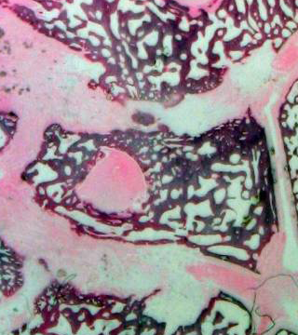
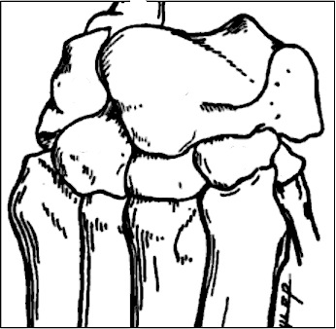
rhPDGF-BB increases the number and extent of fused joints
Autograft
β-TCP
β-TCP/collagen
Autograft + rhPDGF-BB
β-TCP + rhPDGF-BB
β-TCP/collagen + rhPDGF-BB

Slide 32
Enhances Joint Fusion
Conclusions
New bone formed was normal
No evidence of ectopic bone formation
No evidence of acute or chronic toxicity

Slide 33
Strong History of Clinical Research with rhPDGF
Augment® Bone Graft
Description | Patients | Indication | Status
U.S. Pivotal Trial | 434 | Hind Foot/Ankle Fusion | Complete
EU Trial | 108 | Foot/Ankle Fusion | Complete
CAN Trial | 60 | Foot/Ankle Fusion | Complete
U.S. Pilot Trial | 20 | Hind Foot/Ankle Fusion | Complete
DRFx Pilot Trial | 20 | Distal Radius Fracture | Complete
Augment® Injectable Bone Graft
Description | Patients | Indication | Status
U.S. Pivotal Trial | 201 | Hind Foot/Ankle Fusion | Complete
CAN Trial | 75 | Foot/Ankle Fusion | Complete
CAN Pilot Trial | 10 | Foot/Ankle Fusion | Complete
DRFx Pilot Trial | 20 | Distal Radius Fracture | Complete
No evidence of ectopic bone formation, swelling/edema, osteolysis or any other sever device-related complications in these studies

Slide 34
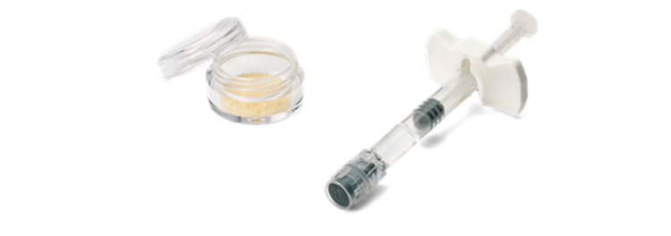
rhPDGF-BB VS. PRP & PRGF / PRF
Product | Blood Volume Required | Activation Required | Contamination Risk During Preparation | Amount of Growth Factor
GEM Vet | NONE | NONE | Extremely Low | 300,000 ng/mL
Platelet Rich Plasma | 20-60 cc | Yes, Bovine Thrombin | Low | 398 ng/mL
Plasma Rich in Growth Factors (PRGF) | 5-4 cc | Yes, Calcium Chloride | Fairly High | 47 ng/mL
GEM VetTM contains significantly more active growth factor than either PRP or PRGF preparations

Slide 35
Comparison to PRP/PRF – 10,000 times the PDGF
PRP System | PDGF-BB Concentration Mean ± SD ng/mL
Cascade (MTF) | 14.8 ± 2.5
GPS II (Biomet) | 23.1 ± 10.1
Magellan (Arteriocyte) | 33.0 ± 8.2
300,000 ng/ml
10,000 fold difference
30 ng/ml
Amounts of PDGF-BB in a standard PRP/PRF preparation are highly variable and contain only one ten-thousandth (10⁻⁴) of that needed to foster bone in human clinical trials
Castillo 2011 (Comparison of PDGF-BB across PRP systems and human samples)
Published in American Journal of Sports Medicine

Slide 36
Comparison to BMP
PDGF and BMP are different molecules with different modes of action
 | rhPDGF-BB | rhBMP
Action | PDGF sparks the early phases of bone repair | Transforms cells into bone forming cells
Mechanism of Action | Chemotaxis Mitogenesis Angiogenesis | Induction
Therapeutic Benefit | Bone Regeneration | Bone Formation
Risk of Ectopic Bone Formation | None | YES
Therapeutic Concentration (Bone) | 0.3 mg/mL | 1.5 mg/mL (INFUSE) (5X higher)
Clinical Complications | No serious device-related adverse events in clinical studies/ marketing history | Complications observed in clinical studies and commercial use

Slide 37
Medtronic Infuse – Adverse Outcomes
30+ peer-reviewed papers documenting severe adverse events including:
Seroma, edema, swelling (retrograde ejaculation)
Dysphagia, breathing difficulties (cervical spine)
Ectopic bone formation (local and distant), leading to nerve root/spinal cord compression, explant
Osteolysis - concern in osteoporotics
FDA Warning Contraindicating Use in Cervical Spine - July 1, 2008
Adverse events reported in FDA MAUDE database - understates problem

Slide 38
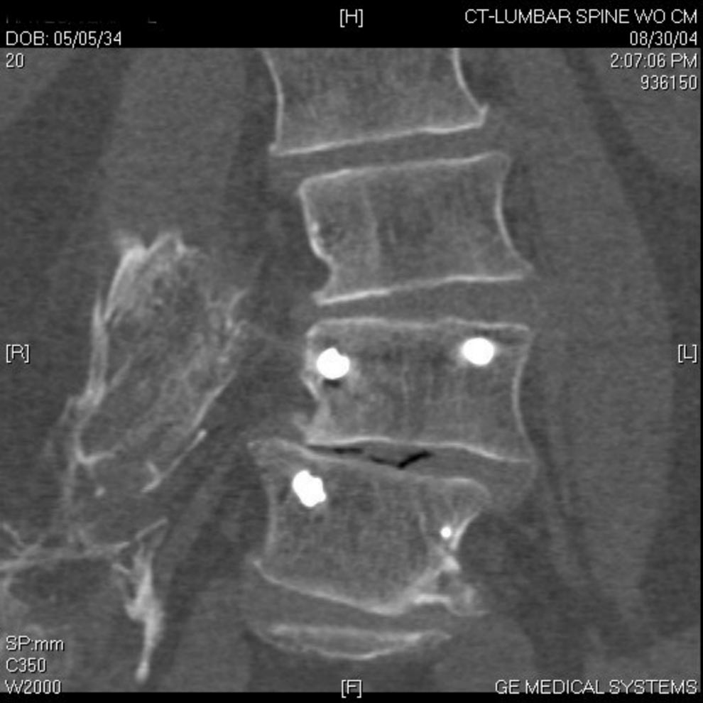
Medtronic Infuse – Adverse Outcomes
The use of BMP has been associated with a number of clinically significant complications (swelling/edema, ectopic bone formation, osteolysis
BMP complications have been the subject of numerous peer-reviewed journal articles, adverse reports to FDA
Cost!
Ectopic bone located a significant distance from the primary operative site (Brower 2008)

Slide 39
Take-Home Messages: rhPDGF-BB
ONLY product FDA approved to stimulate the healing of both bone and soft tissues in dental, orthopedic & dermal wound healing indications
Mechanism of action well established
More potent biologic than PRP/PRF
Long history of safety, rhPDGF products have NO serious adverse events…>300,000 dental patients, 100,000 orthopedic patients 2 million diabetic ulcer patients
Accelerates remodeling leading to faster replacement with the patient’s own bone…
Has a lot of potential for wound healing and tendon healing…

Slide 40
